Slide 1
Chapter 6: The Israelites
Lesson 1: Beginnings
DO NOW
Whether you believe in a certain religion or not, how does religion affect you and your family today?

Slide 2
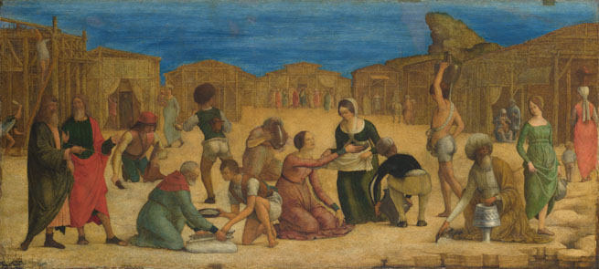
Beginnings
  Ancient Israelite beliefs represent the foundation of _________
  Judaism is both an __________and __________ religion
  Practiced __________– the belief in one all powerful God
    God sent __________– messengers who spread God’s word
    Prophets told the __________ :
      God __________ and ruled the world
      God __________ them to be good
      Individuals could __________ with God through __________

Slide 3
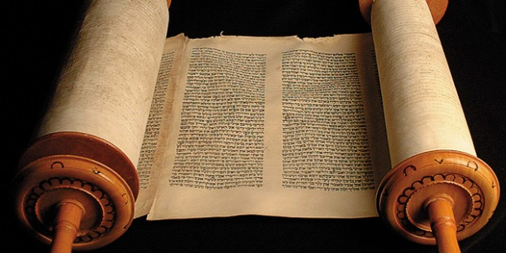
The Hebrew Bible
  Record of the __________ and history of the Israelites
    Also known as the __________
  The teachings of the Hebrew Bible became __________
    Followers today are known as __________
  The __________ population was small but very influential
    Led to development of __________ and __________
  Christians call the Hebrew __________ the Old __________
  Teachings of __________ influenced values, __________, and principles of many other societies

Slide 4
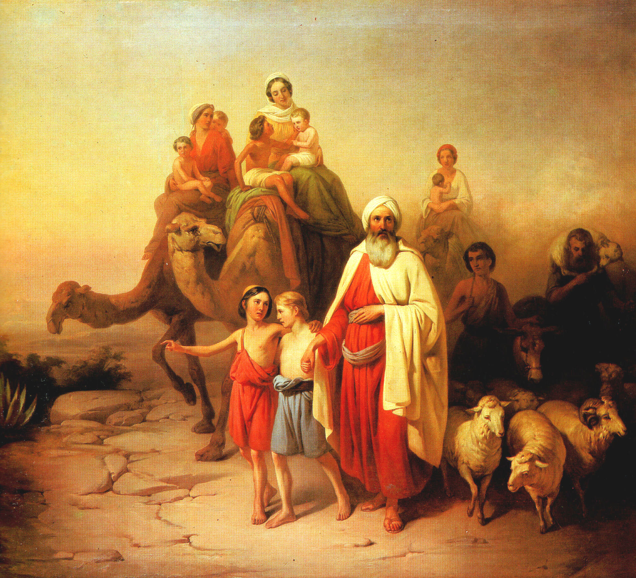
Abraham
  1200 BC – changes occur in Mediterranean region
    __________ empire ends
    New kingdoms, including __________ arise
    Israelites depend on __________ and __________ to survive
  Jews believe they are descendant from __________ and his family
  The Hebrew __________ tells of Abrahams story:
    God tells Abraham to move to __________ with his family
    The land shall belong to his __________ forever
    Abraham and his family accepted __________ promise
      Israel is now referred to as the “__________ Land”

Slide 5
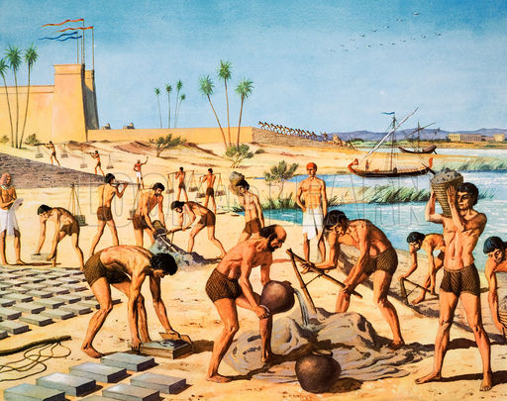
Isaac and __________
  Abraham’s son and grandson, Isaac and Jacob, lead the family after his death
  An __________ gives Jacob the name “Israel”
    Means one who struggles with __________
  Jacob has 12 __________ who become the ancestors of the 12 __________ of Israel
    Tribes – separate family groups
  Israelites move to Egypt due to a __________ in Canaan
    Their population __________, Pharaoh fears rebellion
    Israelites are __________ into slavery

Slide 6
Moses and the Exodus
  Israelites prayed to be freed from Egyptian __________
  God sent the __________ Moses to save them
    Moses saw a __________ bush and heard God’s voice
    God told him to tell the __________ to free the Israelites
    The Pharaoh __________ to free them
    God sent 10 __________ to cause problems for Egypt
    The __________ freed them, but sent his army in chase
    God parted the __________ Sea for the Israelites to cross
    Egyptian __________ is destroyed when they try to cross
    __________ – the departure of the Israelites from Egypt

Slide 7
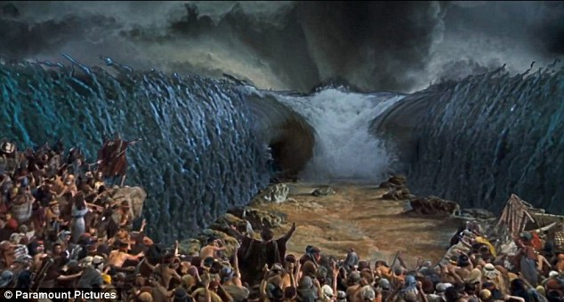

Slide 8
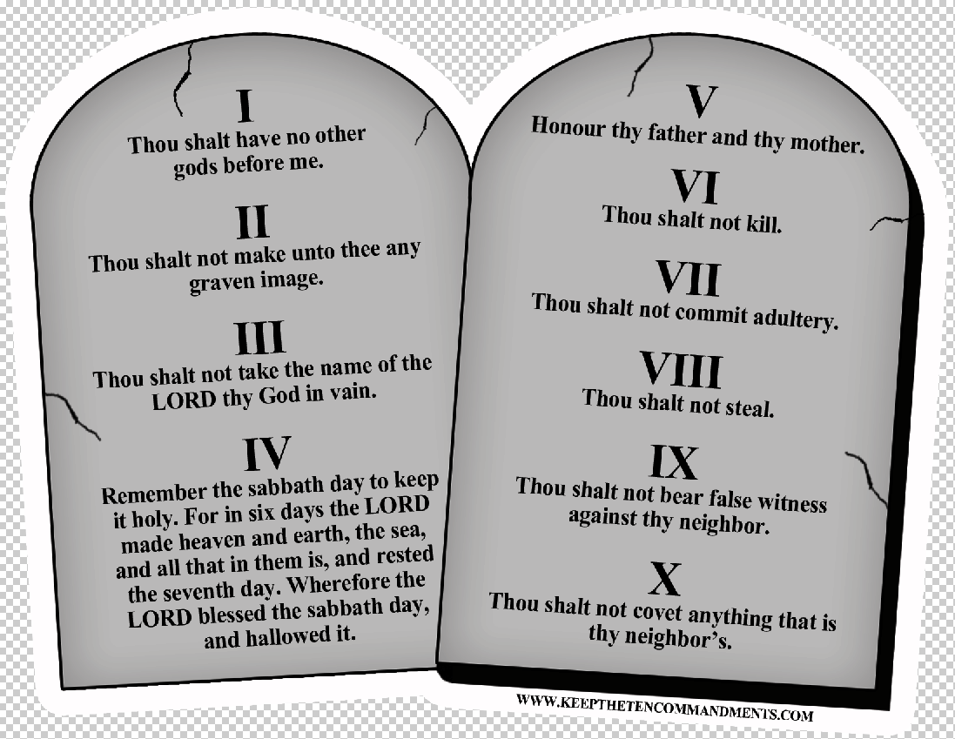
The Covenant
  Israelites upon leaving Egypt receive a __________ – an agreement with God
    God promised __________, they promised to follow his teachings
  Moses is chosen as God’s leader
    Received teaching on Mt. Sinai called the __________
    Included the 10 __________ – God’s rules to follow
    Many laws are based on these teachings

Slide 9
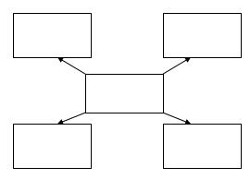
Use this graphic organizer to show what the four major figures of the Israelite people we just discussed contributed to their development.
Abraham, Isaac, Jacob, and Moses

Slide 10
The __________ of Canaan
  Moses died before reaching the __________ Land
  __________ became their new leader
  Found other people living there who were very different
The __________
  These people practiced __________
  Phoenicians
    Skilled _________ and talented traders
    Created an __________ – group of letters that stand for sounds
  The __________
    Known as the “Sea __________”
    Skilled in making __________ tools and weapons

Slide 11
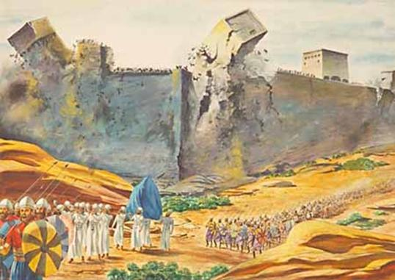
Military __________
  __________ led the Israelites into battles to take Canaan
  All land was divided between the 12 __________
  After Joshua’s death, tribes were led by __________
“Joshua __________ the people, “Shout, for the __________ has given you the city”….at the sound of the __________, when the people gave a loud shout, the wall collapsed.”
From the Hebrew Bible, the book of __________

Slide 12
Life in __________
  Most __________ farmed and __________ animals
  Land was dry so rain water was collected and stored
    Stored in __________ underground
    Used to __________ crops in dry season
  Lived in __________ story houses made of mud-brick or stone
    Families slept on the upper level
The __________
  Israelites worshipped in a __________ called the Tabernacle
  Ark of the __________
    Gold-covered wooden chest containing the __________ Commandments
    Believed it ensured them __________ victory

Slide 13
Chapter 6
Lesson 2: The Israelite Kingdom
Bell Ringer
Explain how the Israelites settled the land of Canaan.

Slide 14
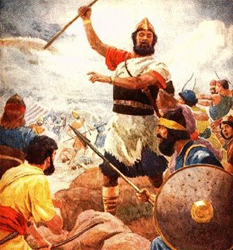
Early __________
  1000 BC – Israelites have settled most of __________
    Developed prosperous culture
    Created an alphabet and __________
    The __________ posed a significant threat to the Israelites
    A king was needed to unite the 12 __________
Saul: The First __________
  __________ the Judge chooses Saul to be the first King
    Warned a King might tax and __________ them
  Saul led the __________ to many victories
  __________ eventually lost the support of his people
    Disobeyed God’s commands
  Samuel chooses a new __________

Slide 15
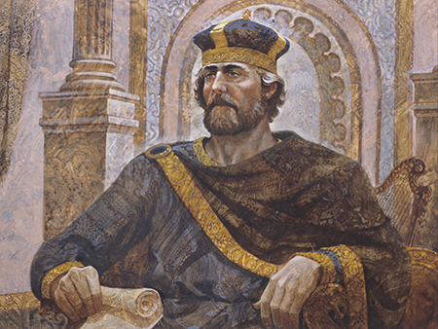
King David
  David was famous for defeating __________
    Goliath was a giant __________ warrior
    Challenged any __________ to a fight
    David accepted with only a staff and a __________
    Defeated __________ with one shot
  King Saul made __________ the army commander
    Became jealous of David
    Tried to kill David, but he __________ and became King
  King David united the __________ and defeated the Philistines
    Established Jerusalem as __________ city
    Wrote many of the Hebrew Bible’s Book of Psalms – sacred __________ or __________

Slide 16
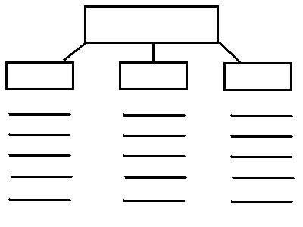
Use this graphic organizer to explain the roles of the 3 kings we discussed:
King Saul, King David, and King Solomon

Slide 17
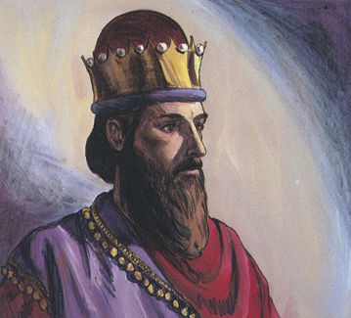
King __________ (continued)
  __________ were very prosperous under David
  Honored as the greatest Israelite __________
  970 BC – David’s son, __________, became the new King
    Brought peace through __________ and treaty
    Constructed the __________ Temple in Jerusalem
      Held the Ark of the __________
    Wrote many __________ – wise sayings
  King __________ loses support of his people
    Demanded __________ taxes
    Treated them as __________ for building
  922 BC – King __________ dies, kingdom splits

Slide 18
Two Kingdoms
  10 northern __________ rebel against Jerusalem
    Found separate __________ of Israel
    Capital was __________
  2 southern tribes form kingdom of __________
    Capital was __________
  These kingdoms felt threatened by their __________
    Assyrians and __________ wanted to control their trade routes
The Fall of __________
  722 BC – Israel refuses to pay tribute to the Assyrians]
    __________ invade Israel
    Captured major cities including __________
    Assyrians and Israelites mixed __________ making Samaritans

Slide 19
The Fall of __________
  597 BC – __________ under King Nebuchadnezzar forced thousands out of Jerusalem
    Moved them to __________
    Nebuchadnezzar chose a new king for the __________
    This king followed orders at first
    Eventually wanted to set __________ free
  A prophet named __________ told the king God did not want him to rebel
    The king led a __________ but was unsuccessful
    Nebuchdnezzar __________ Jerusalem in 586 BC
    This time is known as the Babylonian __________ – forced absence from one’s home

Slide 20
What was the Prophets’ Message?
  __________ had an important role in Judean life:
    Offered words of hope
    Explained when people were not obeying __________
    __________ people to behave and make the world better
Reflection: Why was it important that King David unite the Israelites?

Slide 21
Chapter 6
Lesson 3: The Development of Judaism
Bell Ringer
Why did the Assyrians and Chaldeans want to
take over the Israelite kingdoms?

Slide 22
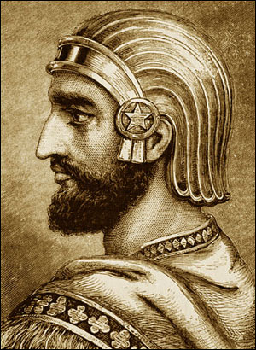
Return to Judah
  Judeans spent 70 years exiled in Babylon
  Became known as the “Jews” during this time
  There were no temples in Babylon
    Jews worshipped in synagogues – Jewish houses of worship
    Worshipped on the Sabbath – weekly day of worship and rest
      This is still observed today
Rebuilding Judah
  Some Jews accepted Babylon as their new home
  Some Jews wanted to return to Judah
  538 BC – the Persians conquer the Chaldeans
    Persian King Cyrus II allows Jews to return to Judah

Slide 23
Rebuilding Judah (continued)
  Many Jews returned to Judah
  Replaced the temple destroyed by the Chaldeans
    Known as the Second Temple
  The Persians chose officials to rule Judah
    Did not allow Jews to have their own government
    Jews depended on religious leaders and scribes to guide them
  Ezra, a scribe, led the Jews to write the 5 books of the Torah
    Written on scrolls – long documents made of parchment sewn together
    This became the Hebrew Bible

Slide 24
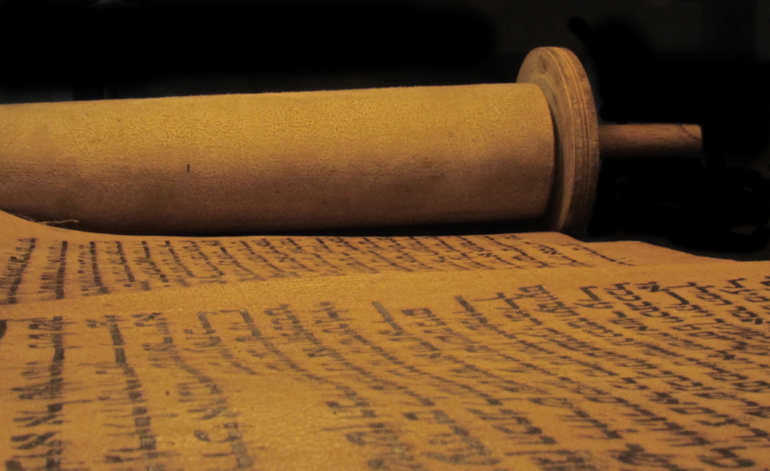
What is in the Hebrew Bible?
  Created to make God’s rules very clear for the Jews
  Written over many centuries
  Includes Jewish art, history, poetry, literature, and proverbs
  Contains 3 parts and 24 books
    The Torah
    The Prophets
    The Writings

Slide 25
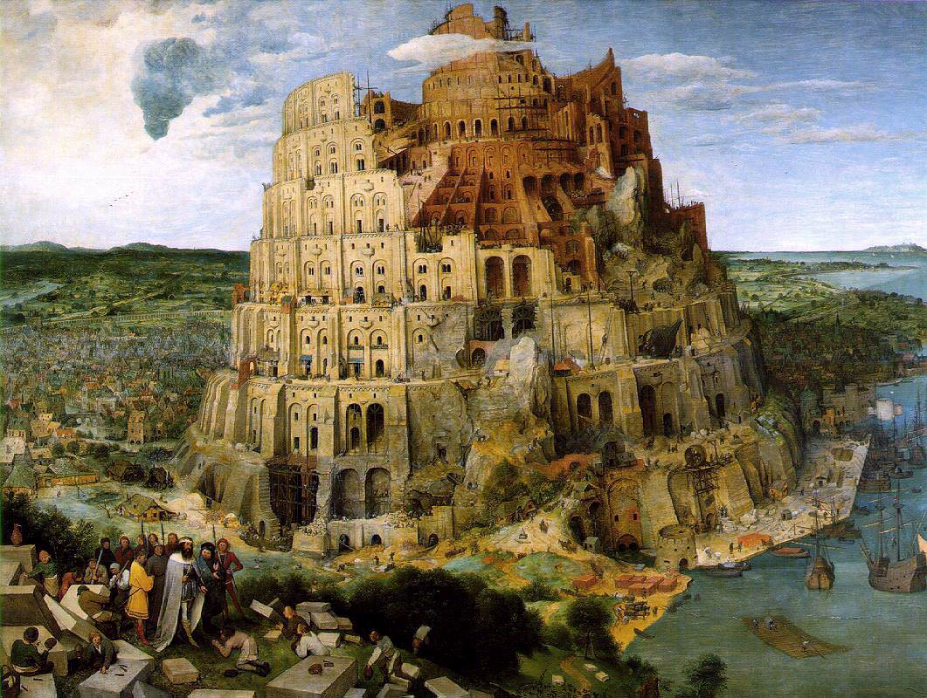
The book of Genesis (the first book)
  Tells of human beginnings
  God created the Earth in 6 days and rested on the 7th
  God punished the world for wicked behavior
  Tells the story of Noah’s Ark
    God warns Noah of a flood, tells him to build an ark
    Noah brings his family and two of every animal
    All is destroyed but those on the ark
  Explains why people speak different languages
    Citizens of Babel try to build a tower to reach heaven
    God disapproves and makes them speak different languages so they couldn’t finish
    Scattered these people all over the world

Slide 26
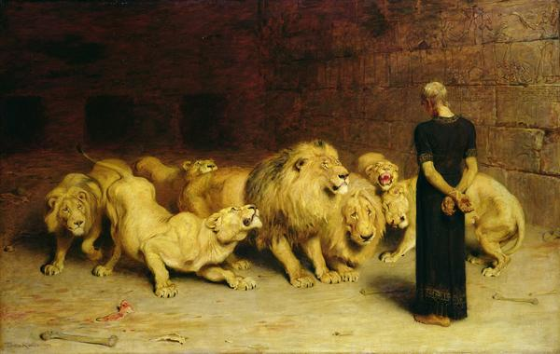
The book of Daniel
  Tells of Daniel, a Jewish advisor to the Babylonian king
  Daniel refused to worship Babylonian gods
  The king throws him in a lion’s den
  God protects Daniel from the lions
  This story reminds Jews that God will protect them
    Good will replace evil
    This idea is shared by Christians and Muslims

Slide 27
Jewish Daily Life
  The Torah provides teachings for daily life
    Shaped family life
    Said what foods to eat/clothes to wear
    Said to be honest and loyal to God
The Jewish Family
  The Torah identified specific roles for the Father and Mother
    If a father died, his son would lead the family
  Required education, especially for young men
    Sons would learn to worship god
    Also learned a trade
    Almost everything was learned from the Torah
      Religious teachers became community leaders
    Daughters learned to be wives, mothers, and housekeepers

Slide 28
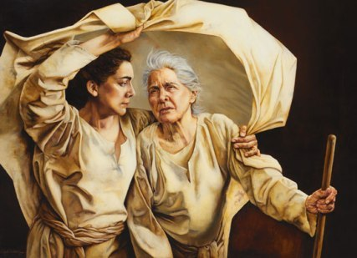
The Story of Ruth and Naomi
  Namoi’s husband and her two sons died
  Ruth was the wife of one of the sons
  Ruth was not a Jew, but decided to leave her people to help Naomi
  Naomi told her no, but Ruth responded:
  “Where you go I will go, and where you stay I will stay. Your people will be my people and your God my God. Where you die I will die, and there I will be buried”
  The Book of Ruth

Slide 29
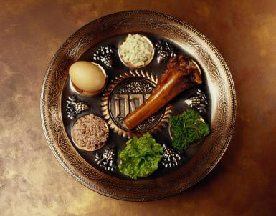
Dietary Laws
  Jewish law decides what they can and can’t eat
    These laws are known as kashrut – that which is proper
      For example: Beef and lamb were okay, but not pork
    They believed this was showing obedience to god
  Today, this is known as kosher – prepared according to Jewish law
    Animals must be killed in a certain way
    The meat must be inspected, salted, and soaked in water
    Meat and dairy can’t be eaten together
    Shellfish is also not allowed
  Some foods have religious significance
    The seder is a meal eaten during Passover
    This celebrates the exodus from Egypt
    The foods include lamb, eggs, vinegar, salt water, herbs, and Matzoh
      These reflect on the history of Passover

Slide 30
Vocabulary Review
Write a paragraph describing traditional Jewish religious practices using the following words:
Synagogue
Sabbath
Kosher
Writing Prompts
Synagogues were… which the Jews would use to…
The Sabbath is…
Kosher food is important for the Jews because…

Slide 31
Chapter 6
Lesson 4: The Jews in the Mediterranean World
Bell Ringer
What do you think was the main lesson to be learned from the story of Daniel in the lion’s den?

Slide 32
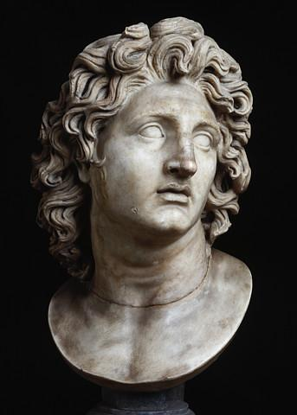
The Arrival of Greek Rule
  Persians ruled over Judah for 200 years
  331 BC – Alexander the Great conquers Persia
    Alexander was the king of Macedonia
    He admired Greek ways and wanted to spread them
    Introduced Greek culture to Judah
    Allowed Jews to stay in Judah

Slide 33
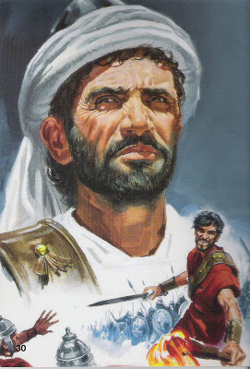
How did Jewish ideas spread?
  Judah remained center of Judaism
  Many Jews lived outside of Judah due to being exiled in the past
    Dispora – groups of Jews living away from homeland
    Jewish beliefs spread as they practiced them where they lived
    Hebrew Bible was translated into Greek, spreading Hebrew beliefs across the Mediterranean
Revolt of Maccabeus
  Alexander’s generals divided empire into separate kingdoms after his death
  200 BC - The Seleucids controlled the kingdom in Southwest Asia
    This included Judah
    176 BC – Antiochus IV forced Jews to worship Greek religion
    167 BC – Judas Maccabeus, a Jewish priest, rebels and forms a rebel army in the hills known as the Maccabees
    The rebels recaptured the Temple and reinstate the Jewish religion
      Hanukkah celebrates this victory

Slide 34
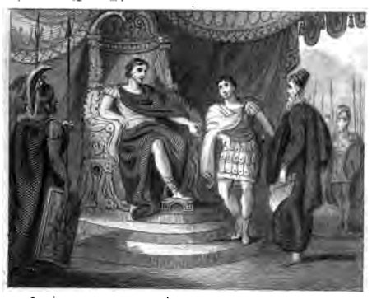
Roman Rule in Judaea
  100 BC – Romans control much of the Eastern Mediterranean lands
    Rome was located far to the west in what is now Italy
    Romans expanded their empire through powerful military
    63 BC – Rome conquers Judah, rename it Judaea
      Romans choose Herod to rule as king
      He builds many forts and cities

Slide 35
Jewish Groups
  Roman officials rule Judaea after Herod’s death
    Jews were unsure how to deal with Romans
  Pharisees
    Gained support of the common people
    Wanted Judaea free of Roman rule
    Urged people not to fight, but to resist Romans
  Sadducees
    Made up of wealthy families
    Many served as priests and scribes
    Favored cooperation with the Romans
  Essenes
    Priests who broke away from the Temple, lived in Qumran
    Prayed for God to release them from Roman control

Slide 36
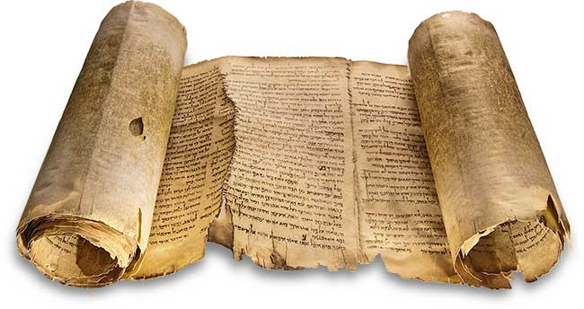
The Dead Sea Scrolls
  AD 1947 – Ancient scrolls found in caves at Qumran
  Most likely written by the Essenes
  Showed that not all Jews practiced the religion the same way
  Not clear why the scrolls were hidden
    Maybe for protection from Romans
The Zealots
  Lived in Judaea
  Wanted to fight for freedom against Romans
  AD 60s – Jewish hatred of Romans reached a peak
    The Zealots were preparing to act

Slide 37
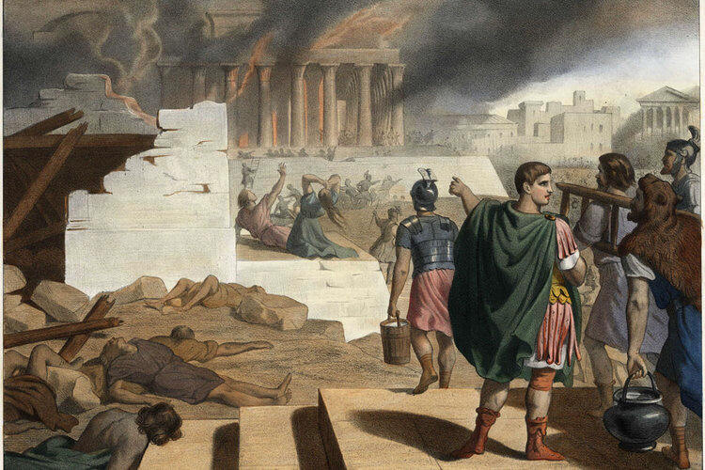
Jewish-Roman Wars
  AD 66 – Zealots revolt against the Romans
    Were able to overpower the small number of Romans in Jerusalem
  Romans return 4 years later to retake the city
    Killed thousands and forced many to leave
    Destroyed the Second Temple
  AD 132 – Simon ben Kosiba led Jews in another rebellion
    Crushed by the Romans in 3 years
    Romans killed many Jewish leaders, including Simon ben Kosiba
    Romans forbid Jews to come to Judaea, renamed in Palestine

Slide 38
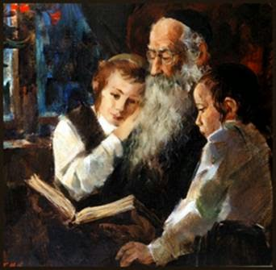
The Rabbis
  Rabbi - Jewish religious leader
    Helped the Jews regroup after their defeats
    Taught the Torah in synagogues
  Yohanan ben Zaccai
    A rabbi who persuaded the Romans to spare the Jewish city of Yavneh
    Founded a school at Yavneh that became a center for religious teachings
    Through his efforts and other rabbis, the Jewish religion was preserved
  Rabbis gathered to record their discussions of Jewish law
    This book was known as the Mishnah
    They combined this with other Jewish traditions into a collection called the Talmud
      The Talmud is still to this day the ultimate authority on Jewish law

Slide 39
Writing Activity
Explain how the Jews reacted to Roman rule of their homeland. Be sure to include the reactions of the Pharisees, the Sadducees, the Essenes, and the Zealots. Also, explain what happened during the two revolts by the Jews against the Romans.
Writing Prompts
The Pharisees believed the Jews should……
The Sadducees believed the Jews should….
The Essenes prayed for….
The Zealots wanted to….
The Jews tried to rebel twice, but…..

